Slide 1

7th Grade Accelerated Math
Unit 3, Lesson 8 Writing Large Numbers in Scientific Notation Volume 1, pg. 139

Slide 2


Benchmarks
MA.8.NSO.1.3
Extend previous understanding of the Laws of Exponents to include integer exponents. Apply the Laws of Exponents to evaluate numerical expressions and generate equivalent numerical expressions, limited to integer exponents and rational number bases, with procedural fluency.
MA.8.NSO.1.4
Express numbers in scientific notation to represent and approximate very large or very small quantities. Determine how many times larger or smaller one number is compared to a second number.
volume 1, pg. 139

Slide 3
Integrated Mathematical Thinking and Reasoning Standards
MA.K12.MTR.1.1 Actively participate in effortful learning both individually and collectively.
MA.K12.MTR.2.1 Demonstrate understanding by representing problems in multiple ways.
MA.K12.MTR.3.1 Complete tasks with mathematical fluency.
MA.K12.MTR.4.1 Engage in discussions that reflect on the mathematical thinking of self and others.
MA.K12.MTR.5.1 Use patterns and structure to help understand and connect mathematical concepts.
MA.K12.MTR.7.1 Apply mathematics to real-world contexts.
volume 1, pg. 139

Slide 4

Learning Targets
I can use the laws of exponents to evaluate numerical expressions with a base of 10 and exponents greater than or equal to 0.
I can express large numbers using scientific notation.
I can determine how many times larger or smaller a number is compared to another expressed in scientific notation.
volume 1, pg. 139

Slide 5

Warm-Up
volume 1, pg. 140

Slide 6
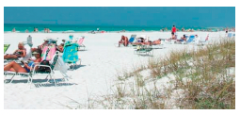
3.8.1 Warm-Up: Grains of Sand
The beaches on Siesta Key are 99% quartz, meaning that the beaches are made of some of the finest grains of sand.
Suppose you have a teaspoon of the sand from Siesta Key. How could the teaspoon of sand be used to estimate the number of grains of sand in a bucket of sand?
volume 1, pg. 140

Slide 7
A group of researchers at the University of Hawaii used a teaspoon of sand to estimate the number of grains of sand on all of the beaches on the Earth. Their estimate was that there are roughly seven quintillion, five hundred quadrillion grains of sand. A quintillion is 1,000,000,000,000,000,000 and a quadrillion is 1,000,000,000,000,000.
2. Write seven quintillion, five hundred quadrillion.
volume 1, pg. 140

Slide 8

Exploration
volume 1, pg. 140

Slide 9

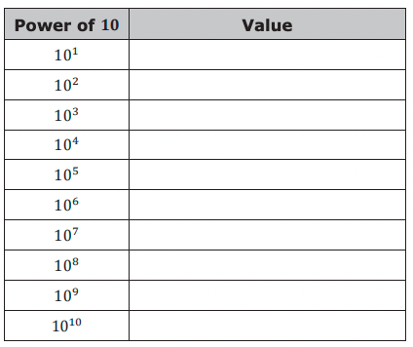
3.8.2 Exploration: Powers of Ten
Use a scientific calculator to find the value of each power of 10.
What do you notice about the relationship between the power of 10 and its value?
volume 1, pg. 140

Slide 10
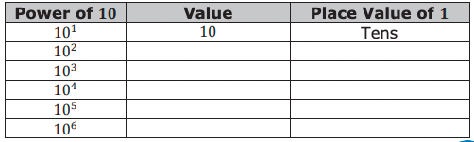

Work with your partner to complete the table
Work with your partner to describe how the exponent of the power of ten relates to place value.
Based on the pattern in the table, what is the value of ${10}^{0}$?
volume 1, pg. 140-141

Slide 11
Exploration
volume 1, pg. 141

Slide 12
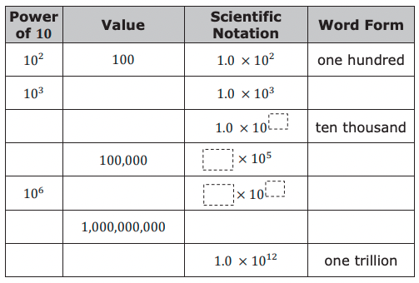
3.8.3 Exploration: Patterns on Scientific Notation
Very large numbers can be written using powers of 10 in a shorthand method called scientific notation.
Work with your partner to complete the table.
volume 1, pg. 141

Slide 13
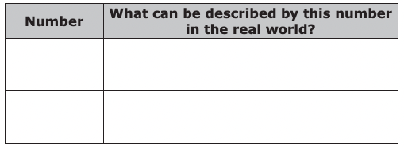
Select two of the numbers. Work with your partner to name something in the world that is described by those numbers.
Work with your partner to describe at least two patterns in the relationships among the power of 10, the numerical value, the scientific notation, and/or the word form.
a.
b.
volume 1, pg. 141-142

Slide 14

Guided Instruction
volume 1, pg. 142

Slide 15


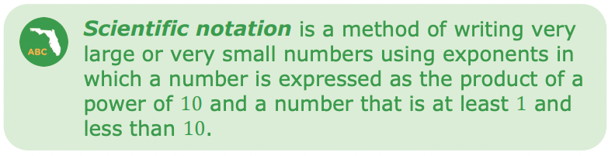
3.8.4 Guided Instruction: Writing Large Numbers in Scientific Notation
Consider the number 2,000,000.
What power of ten represents 1 million?
Complete the multiplication sentence to express 2,000,000 using this power of 10.
volume 1, pg. 142

Slide 16
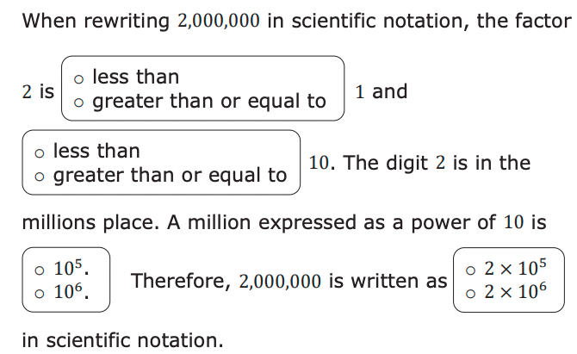
2. Complete the statement.
volume 1, pg. 142

Slide 17

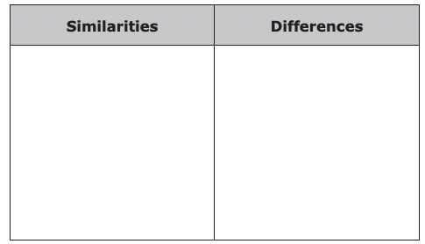
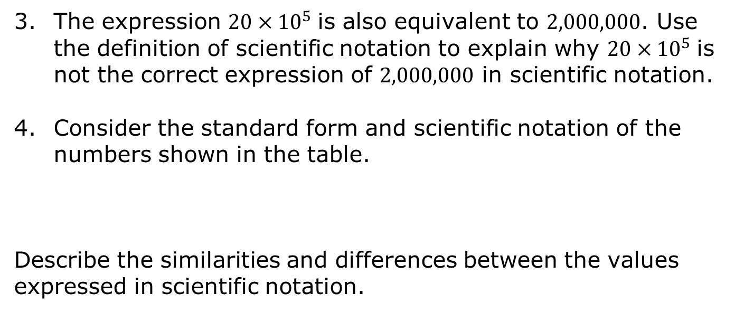
The expression 20 × ${10}^{5}$ is also equivalent to 2,000,000. Use the definition of scientific notation to explain why 20 × ${10}^{5}$ is not the correct expression of 2,000,000 in scientific notation.
Consider the standard form and scientific notation of the numbers shown in the table.
Describe the similarities and differences between the values expressed in scientific notation.
volume 1, pg. 143

Slide 18
As explored in the previous lesson, the powers of 10 relate directly to place values.
5. The planet Venus is about 26,000,000 miles from earth.
What value between 1 and 10 could be multiplied by a power of 10 to result in 26,000,000?
Which digit is in the ones place of your answer to Part A?
In which place value is that digit in 26,000,000?
Which power of 10 relates to this place value?
Express 26,000,000 in scientific notation.
volume 1, pg. 143

Slide 19
In 2018, funding for education in Florida totaled $30,100,000,000. Express this value in scientific notation.
volume 1, pg. 143

Slide 20

Collaboration
volume 1, pg. 144

Slide 21

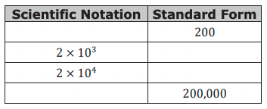
3.8.5 Collaboration: Comparing Large Numbers Written in Scientific Notation
Work with your partner to complete the following.
a. Complete the table.
volume 1, pg. 144

Slide 22
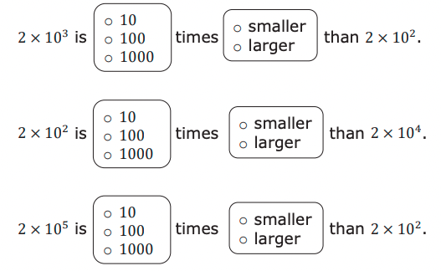
b. Complete each statement.
c. Describe how to compare numbers written in scientific notation if the factors being multiplied by a power of 10 are the same.
volume 1, pg. 144

Slide 23
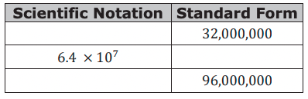
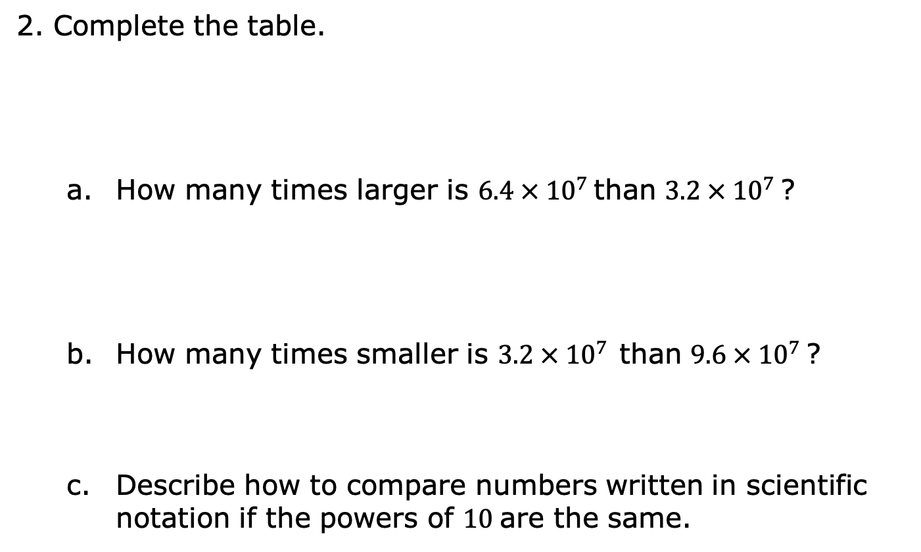
2. Complete the table.
How many times larger is 6.4 × ${10}^{7 }$than 3.2 × ${10}^{7 }$?
How many times smaller is 3.2 × ${10}^{7 }$ than 9.6 × ${10}^{7 }$?
Describe how to compare numbers written in scientific notation if the powers of 10 are the same.
volume 1, pg. 144

Slide 24
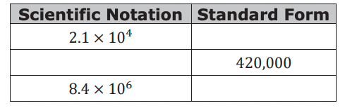
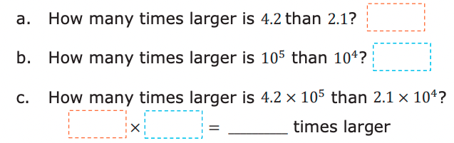
3. Complete the table.
volume 1, pg. 144

Slide 25
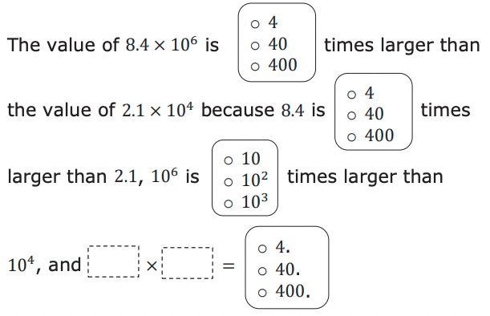
d. Complete the statement.
volume 1, pg. 145

Slide 26
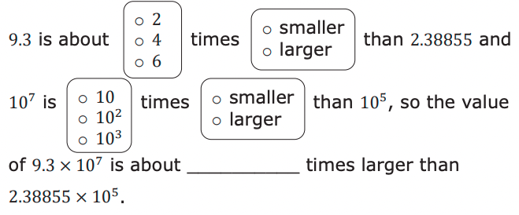
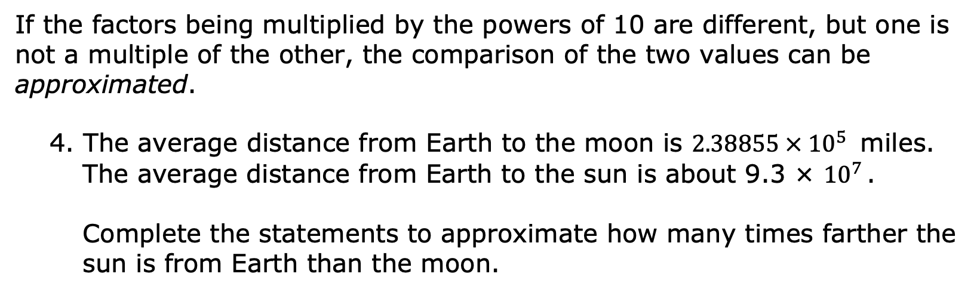
If the factors being multiplied by the powers of 10 are different, but one is not a multiple of the other, the comparison of the two values can be approximated.
4. The average distance from Earth to the moon is 2.38855 × ${10}^{5 }$ miles. The average distance from Earth to the sun is about 9.3 × ${10}^{7 }$.
Complete the statements to approximate how many times farther the sun is from Earth than the moon.
volume 1, pg. 145

Slide 27

Wrap-Up
volume 1, pg. 145

Slide 28
3.8.6 Wrap-Up: Cool Down
Explain how to express large numbers using scientific notation in your words.
volume 1, pg. 145

